Slide 1

Capstone project Team 10
Avinash Devineni
Uttaran Tribedi
Nasreen Mugal
Chaitanya Maloth
Nikita Goswami
Akshay Ramesh

Slide 2
Agenda
Problem statement
Project objectives
Project overview
Summary of approach
Named entity recognition
The dataset
The custom BERT approach:
BERT finetuning
Text to Text mapping
Text to class name mapping
Challenges & mitigation strategies
Recommendations

Slide 3
Problem Statement
While most of the data required to identify the key players in each segment is available in the public domain, we still face the following challenge:
It’s time consuming to manually identify the company’s client types

Slide 4
Project Objectives
Canton has built tools that we can extend in order to help solve some or the problems stated. The objective of this project is
To identify the types of clients served by the players

Slide 5
Project Overview
Identify Market Segments
Identify Players in Each Segment
Identify the value proposition of each player *
Identify each player’s capabilities (core offerings)
Use visualization to present the results
Identify the clients served by each player

Slide 6
The approach
Customized the webscraper to get our relevant data
Tried NER (Named Entity Recognition) with the given data
Applied multiple BERT based modeling approaches

Slide 7
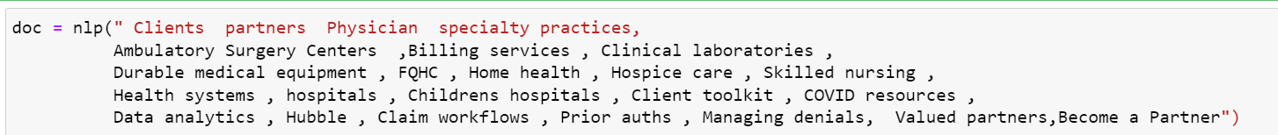
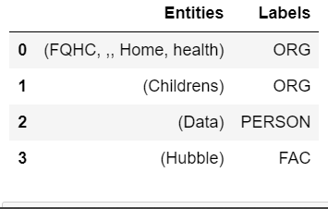
Named Entity Recognition
Applied NER using NLTK and spaCy
Conclusion: NER did not give us satisfactory results for us to move ahead with

Slide 8
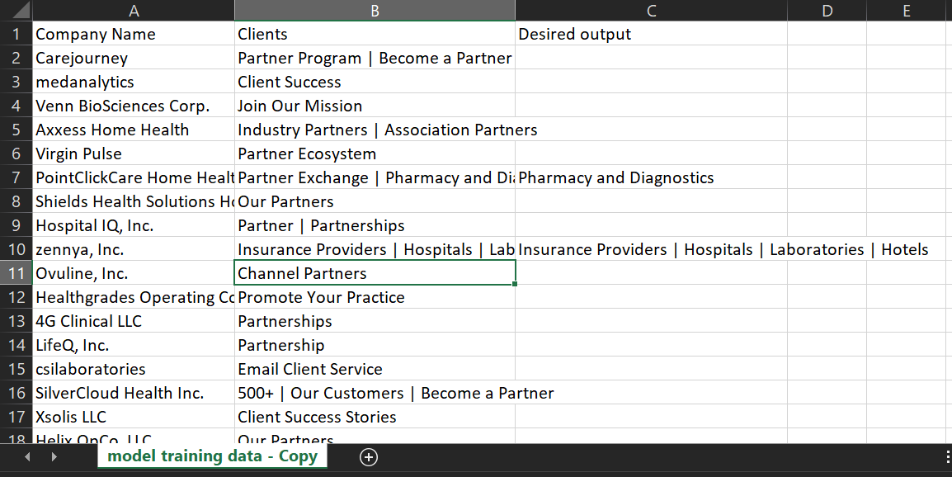
The dataset
Original dataset from running web scraper (number of rows 704)
Addition of new column ‘Desired output’
Total rows: 239 after data cleaning
Relevant rows that will be used is only about 80

Slide 9
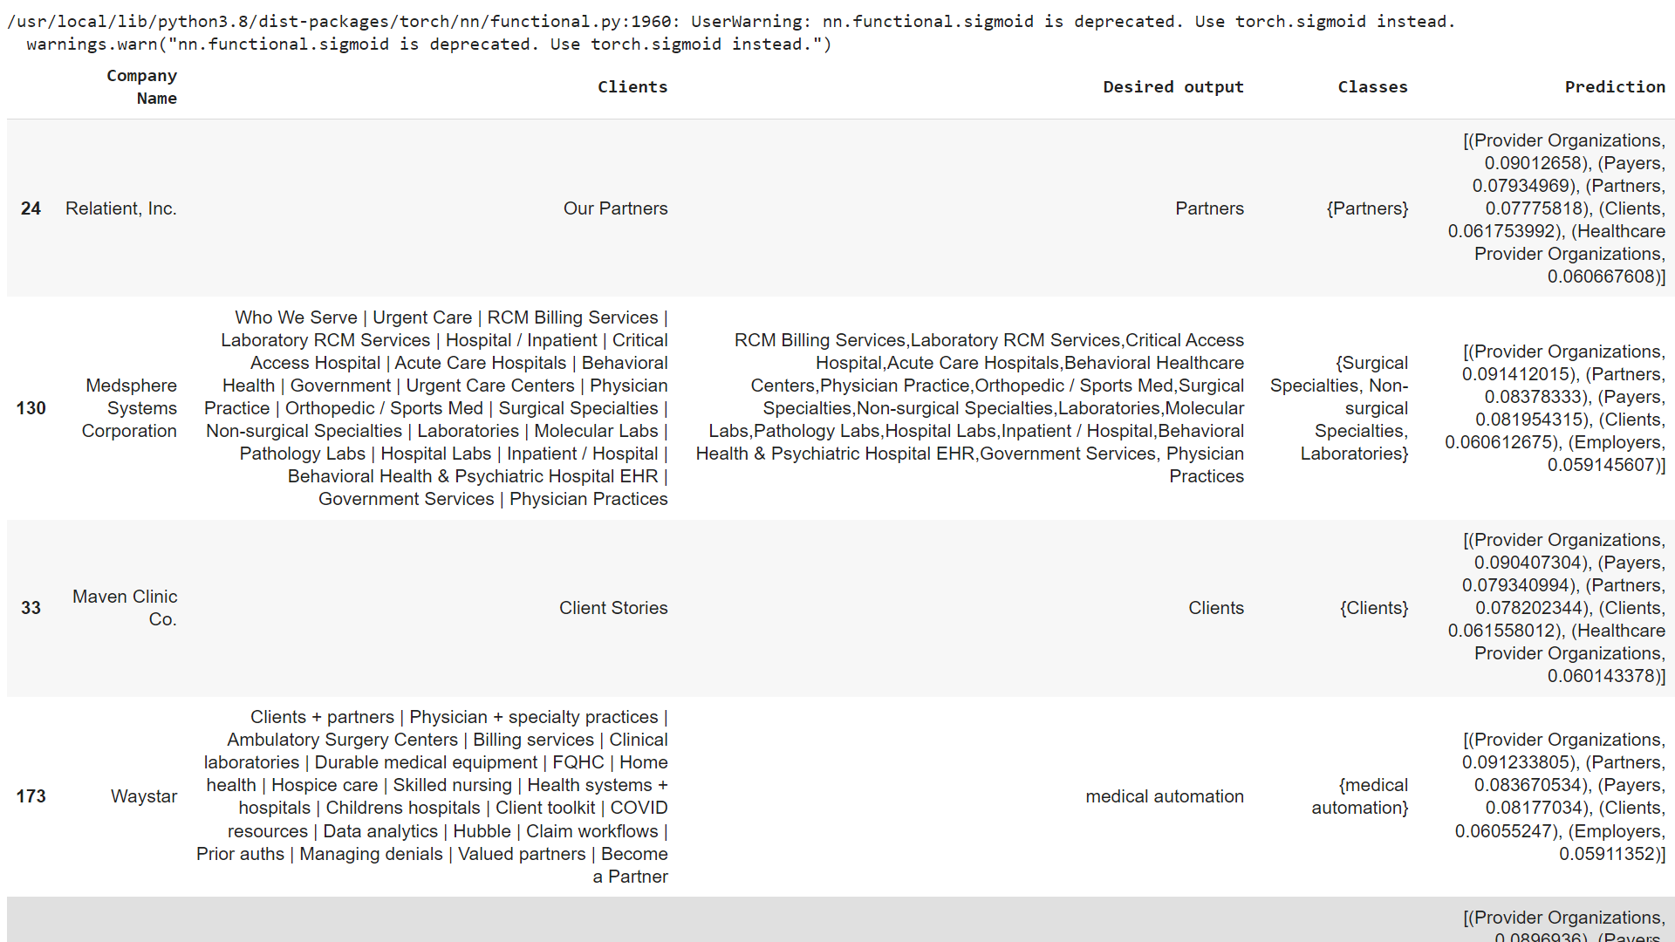
BERT based approach
Approach 1: Using customized BERT finetuning
AUC-ROC score of 0.6 which is not promising

Slide 10
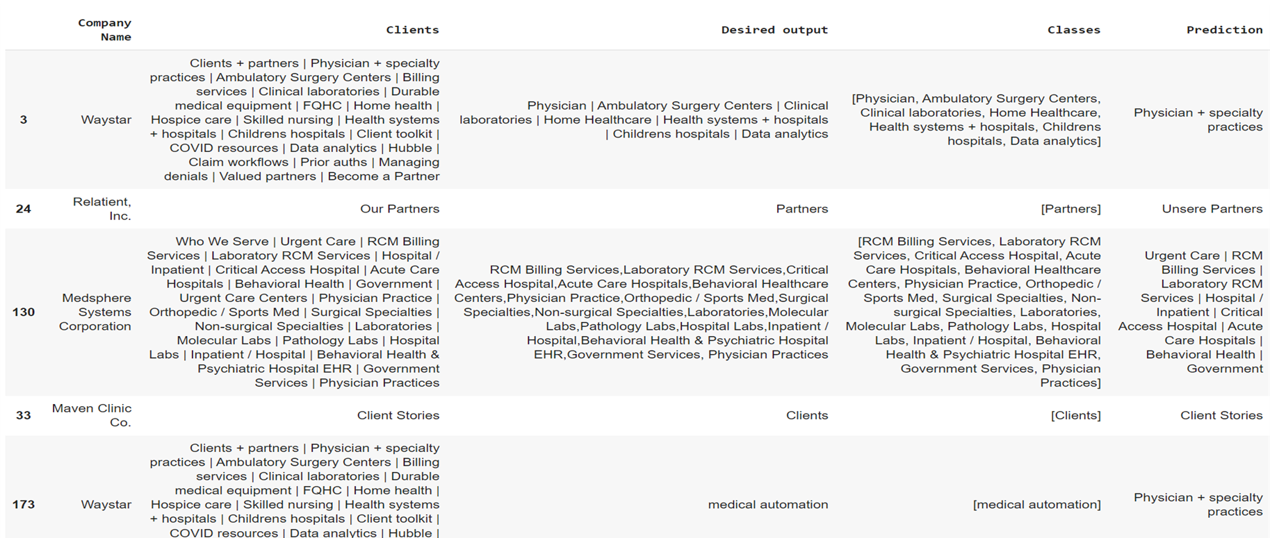
BERT based approach
Approach 2: Text to text approach
Better than previous approaches but still not up to the mark

Slide 11
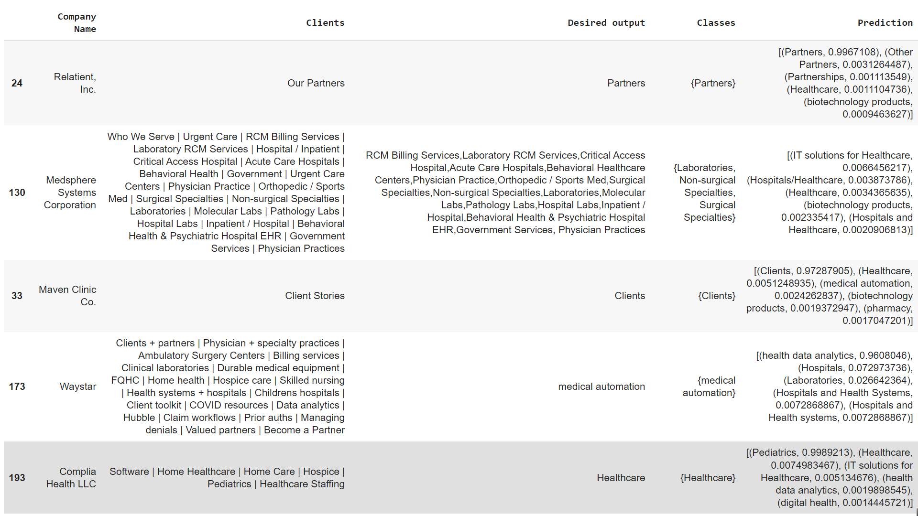
BERT based approach
Approach 3: Text to class name approach
Comparatively best amongst all three approach (AUC-ROC score of .91)

Slide 12
Challenges & appropriate mitigation strategy discussion
Insufficient data
Complications due to different page structures of web pages of organisations
Desired data under different headers/titles
Vaguely defined output(e.g.: corporates, third party vendors, Government bodies etc)
Prediction of unknown classes from test data

Slide 13
Recommendations
We recommend collecting more training data
Access to more computational power to run more complex models and higher iterations
To look and try with other state of the art transformer-based model

Slide 14
Thank You!

